Slide 1
TA Report System
Integrated Exercise for Software II
Team Pikachu:
s1292011 Youssef Yuto Obata
s1282007 Marie Merci Habineza
Supervisor: Professor Rage Uday Kiran
TA: Ms. Madhavi Palla

Slide 2
Contents 内容:
The Process ( Planning, Designing, Creating Diagrams/graphs/ Developing)
The Product & Enhancements (Demo)
Contributions & Learnings from the Activity

Slide 3
TA Report System
Why Develop this System?
over reliance on paper of the current system
Heavy burden on both students and university staff, especially SAD
Frequent submission of incorrect reports

Slide 4

The Development Environment:
Front-end: Flutter(dart)
Backend: Node.js
Database: MySql

Slide 5
The Development Process:
Phase Backlog
Product Backlog
Diagrams ( Use- Case Diagrams, Class Diagrams, Sequence Diagrams)
UI – Definition
Coding – Testing
1
2
3
4
5

Slide 6
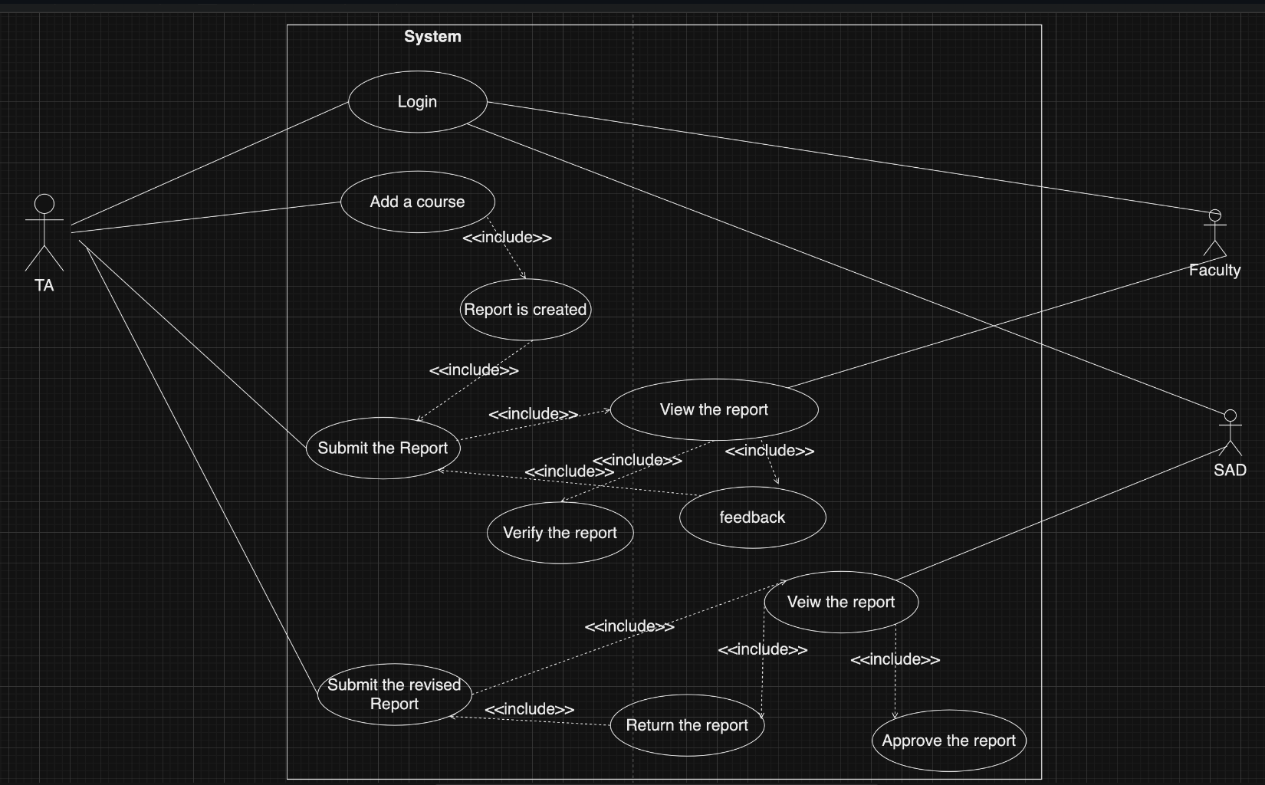
How Users are Expected to Use our System:

Slide 7
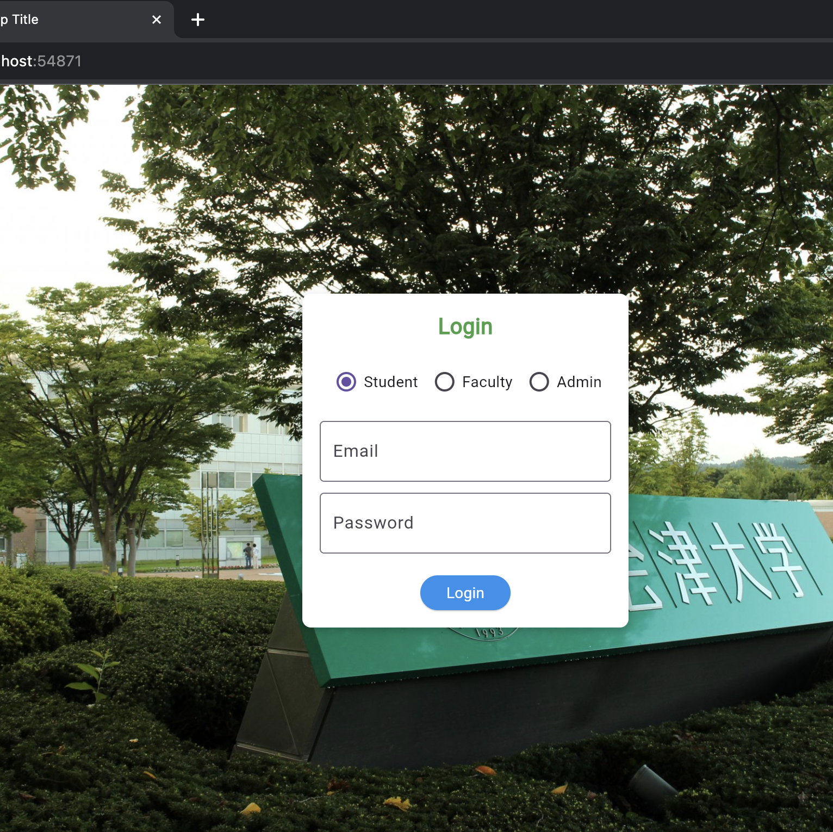
The Product: (Demo)

Slide 8
Contributions 貢献度
※Work_Efficiency = LOC/Total_hours
Member | Analysis （hours） | Design （hours） | Coding （hours） | Test （hours） | Total （hours） | LOC | Work Efficiency
Merci | 15 | 20 | 80 | 20 | 135 | 1546 | 5.94
Youssef | 15 | 20 | 70 | 20 | 125 | 2092 | 8.04
Total | 30 | 40 | 150 | 40 | 260 | 3638

Slide 9
Learnings 得た学び
Programming-wise:
It is not ideal to separate the frontend and the backend
Importance of commit messages when pushing/pulling
We should focus on having a mvp
Personality-wise:
Boosted our confidence in ourselves
Communication is key
Teamwork makes the dream work

